Slide 1
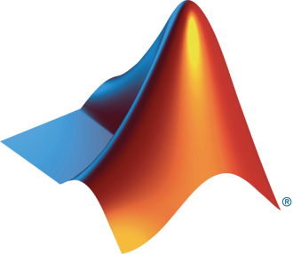
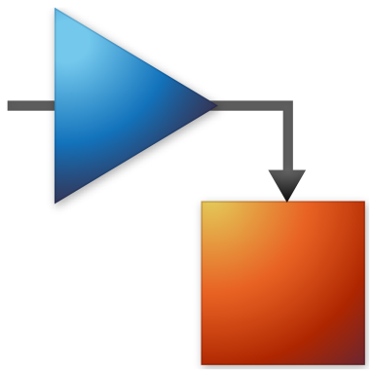
Society/Club name and MathWorks Present: Computer Vision Onramp

Slide 2
Today:
6:15 pm – 6.30 pm: Set-up
Intro to Computer Vision
Create MathWorks account
Log in to Computer Vision Onramp / Test MATLAB Online
6.30 pm – 8.00 pm: Computer Vision Onramp (on your own)

Slide 3
Agenda
What is Computer Vision
App based workflow
Image segmentation and morphology
Object detection and tracking
Summary
Notes:
The agenda
What is CV
App based workflow
Image segmentation and morphology
Object detection and tracking
Summary
So, lets jump right in! 👆

Slide 4
What is Computer Vision?
Notes:
Computer vision is a field of artificial intelligence (AI) that enables computers and systems to derive meaningful information from digital images, videos and other visual inputs

Slide 5
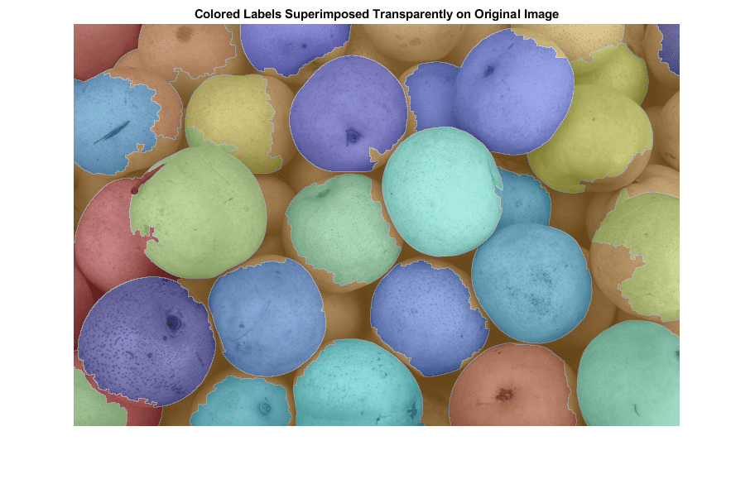
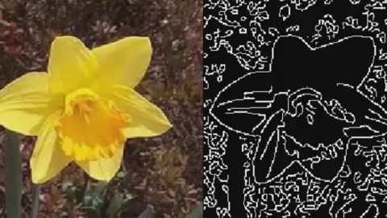
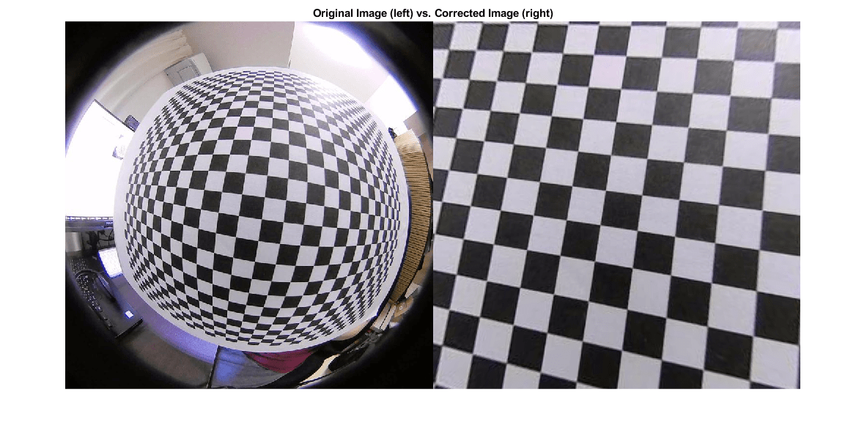
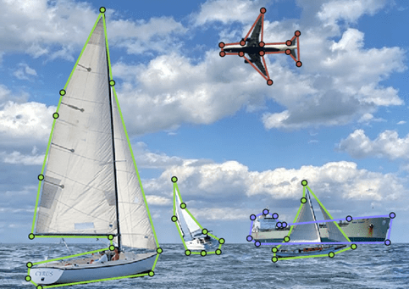
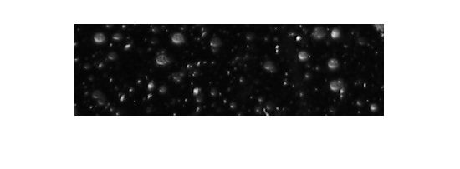
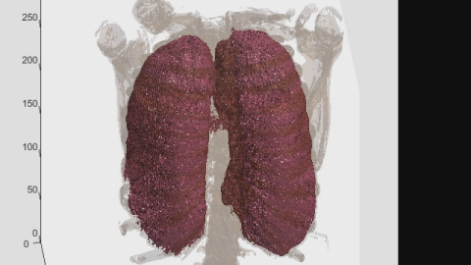
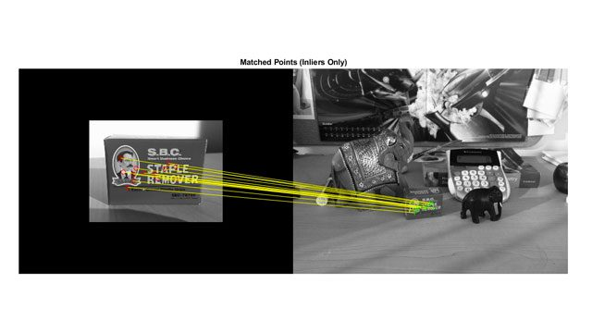
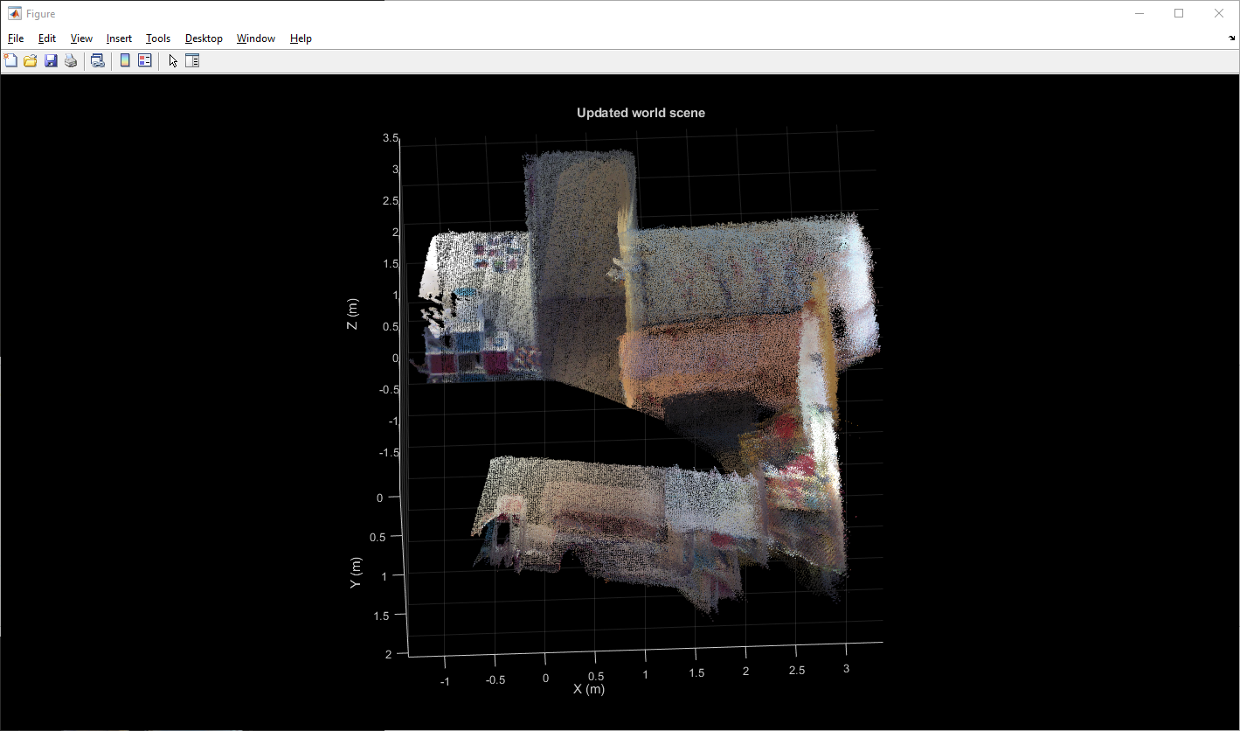
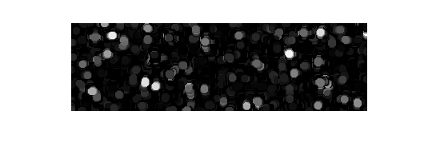
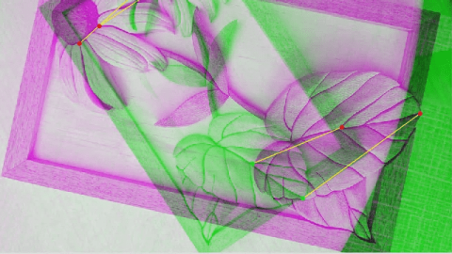
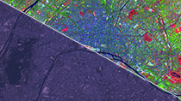
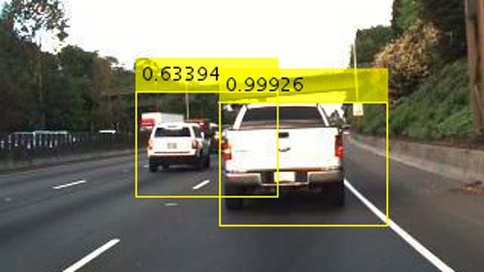
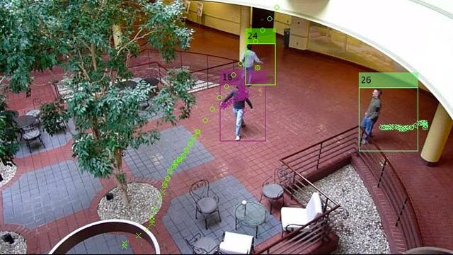
Image Processing and Computer Vision Techniques
Segmentation
Edge Detection
Camera Calibration
Labeling
Morphology
3D Image Processing
Feature Detection
Point Cloud Processing
Image Registration
Image Enhancement
Object Detection
Tracking
Notes:
Before we get into the details, we first need to get a sense of what IP and CV are and here are some of the techniques. We normally consider the blue areas to be IP and orange areas to be CV but the distinction between these is fuzzy.
Under IP, you have segmentation used here to separate apples in the image, edge detection to detect the edges of the flower, morphology used to estimate the size of snowflakes, and image enhancement techniques such as enhancing the contrast of an aerial city images. Image registration helps you align two images that are similar and 3D vision processing enables working with 3D images or volumes such as the image of human lungs.
Under CV, you can use camera calibration to undistort images, use labeling tools to create training data for deep learning networks, work with point cloud data, use feature detection to find objects in images, use object detection to find cars or even track those detected objects.
While I have separated the capabilities out, a lot of time, a combination of these techniques is needed to solve IPCV problems.

Slide 6
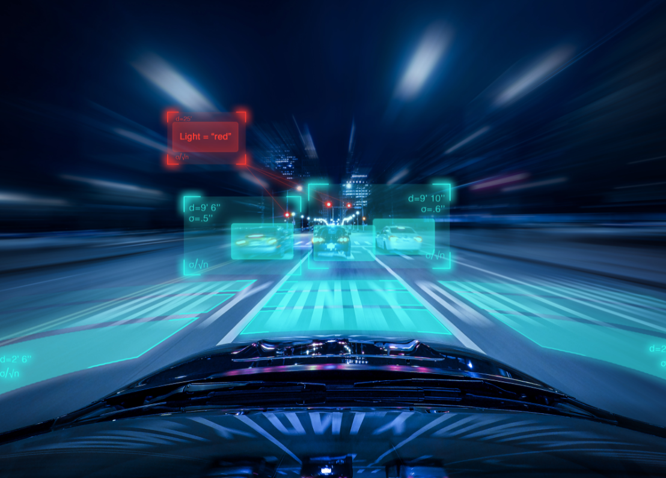
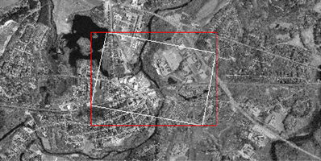


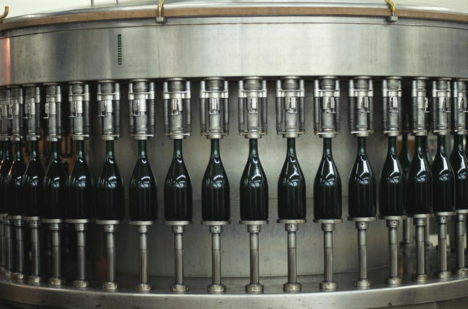
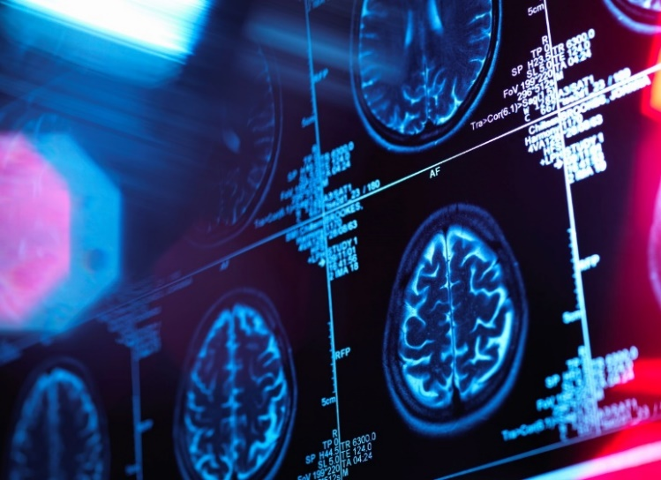
Image Processing and Computer Vision Applications
Automated Driving
Satellite Imagery
Consumer Electronics
Robotics
Machine Vision
Medical Imaging
Notes:
MathWorks image processing and computer vision capabilities are used extensively in various industries such as: Automated Driving, Satellite Imagery, Medical imaging, Consumer electronics, Machine vision, Surveillance, Robotics, and more…

Slide 7
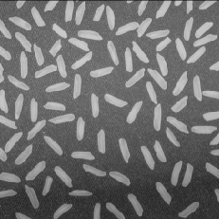
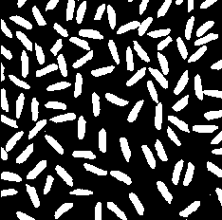
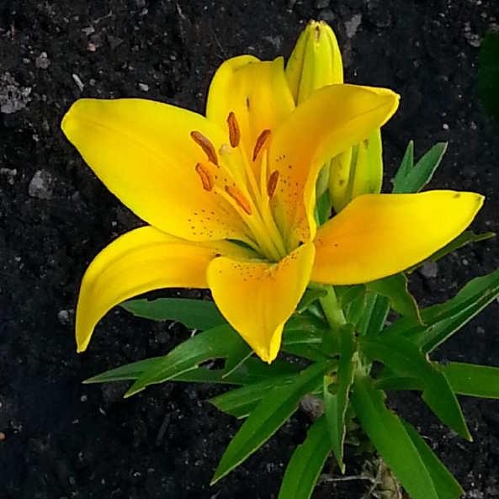
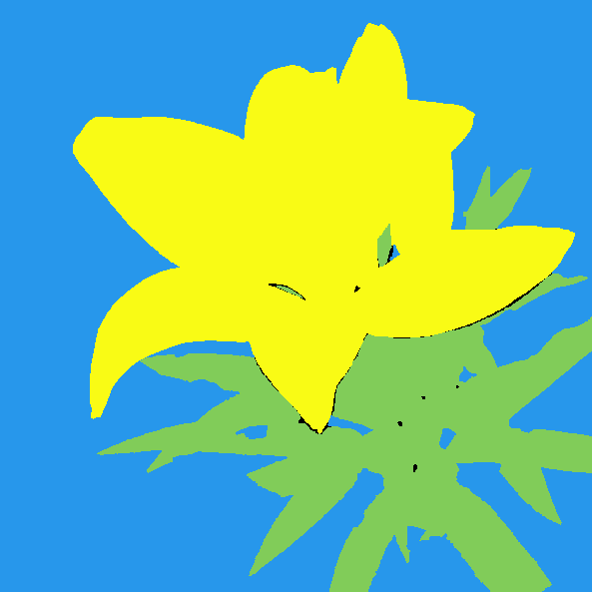
Image Segmentation
Creating masks where ROIs with similar traits are assigned the same value
Image Segmentation
Notes:
Segmentation refers to the process of creating masks of an image, such that regions of interest (ROIs) having similar traits are assigned the same value. That is, we make associations between pixels in the image. These associations, or Regions of Interest, could be based on intensity, color, texture, shape, position, or anything else. Binary segmentation separates the image into two classes—true (white) or false (black). But you can actually make any number of segmentation masks for a single image. 👆

Slide 8
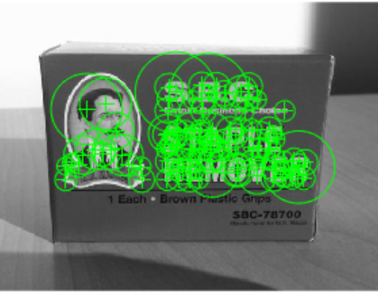
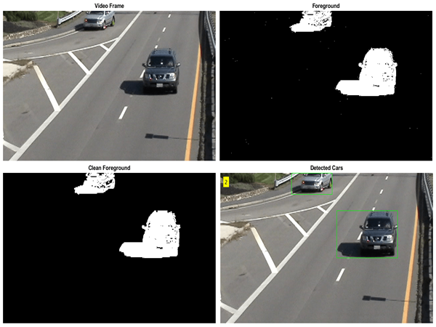
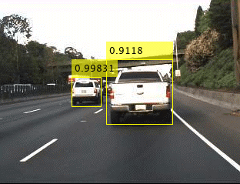
Detection
Object detection is a technique for locating instances of objects in images or videos
Feature or Pattern Matching
Foreground Detection
Deep Learning Detection
Notes:
Object detection is a technique used to detect the presence of specific objects in an image or video.
There are multiple ways you can do this some of which are:
👆 Using features or patterns on the object that make it unique
👆 Using a foreground detector in videos with a fixed background to find moving objects such as cars
👆 Or using deep learning to train networks to detect objects 👆

Slide 9
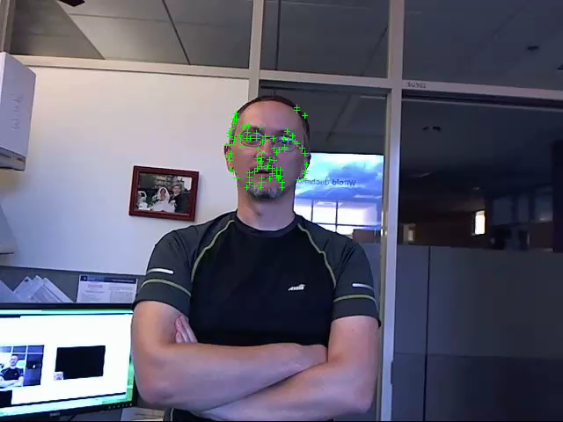
Tracking
Tracking is the process of locating a moving object over time in a video
Notes:
The second part of this section is tracking which is the process of locating a moving object over time in a video.
Here we see a feature detector like the one in the previous slide, used to find the person’s face in the first frame of the video, and then track it through the rest of the video using a tracking algorithm. 👆

Slide 10
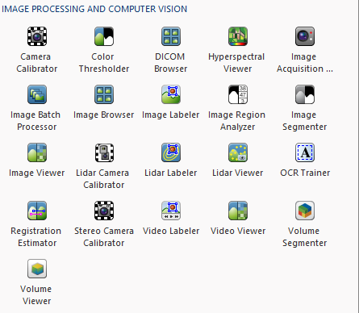
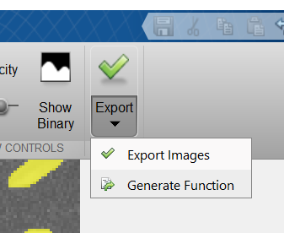
IPCV Apps Accelerate Workflow
Apps provide interactive tools for tweaking parameters and visualizing results
Notes:
IPCV ships with many apps that accelerate workflow. They provide interactive tools for tweaking parameters and visualizing results.
You can load an app, load the images, video or point clouds into it, and analyze them using various techniques until you are happy with the results. When you are finished, you can export your results or generate a function to scale your algorithm to a larger dataset or to incorporate into a workflow. 👆

Slide 11
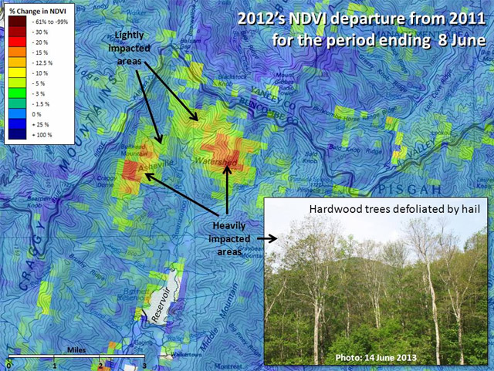
NASA Develops Early Warning System for Detecting Forest Disturbances
Challenge
Develop a system that uses satellite imagery to quickly detect forest disturbance threats from insects, drought, storms, blights, wildfires, and other events
Solution
Use MATLAB to process multispectral satellite images, construct multidimensional time-series data baselines, and analyze terabytes of data to help detect regionally evident forest disturbances
Results
New ideas implemented and tested in hours
Years of development time saved
Reusable production software delivered to growing user community
U.S. Forest Change Assessment Viewer map showing damage to the Asheville, North Carolina watershed following a 2012 hail storm. Image courtesy ForWarn.
“Soon after ForWarn moved into production, it detected previously unnoticed hail damage that posed a threat to a watershed. We would not have been able to do this work as efficiently without MATLAB.”
– Duane Armstrong, NASA Stennis Space Center
Link to user story
Notes:
Industries: Earth and ocean sciences, Aerospace
Application Areas: Data analytics, Image processing and computer vision
Capabilities: Data analysis, Algorithm development, Desktop and web deployment
Products Used: MATLAB, Image Processing Toolbox, Mapping Toolbox, MATLAB Compiler, Optimization Toolbox, Signal Processing Toolbox
Country: USA
NASA Develops Early Warning System for Detecting Forest Disturbances
Working with the U.S. Department of Agriculture Forest Service and the U.S. Geological Survey, NASA’s Stennis Space Center developed ForWarn, an environmental monitoring and assessment tool that detects and tracks changes in forest vegetation nationwide. ForWarn software analyzes multispectral satellite imagery collected by MODerate resolution Imaging Spectroradiometer (MODIS) instruments on NASA’s Terra and Aqua satellites. Every 8 days, the software identifies in near real time potential forest disturbances caused by insects, drought, storms, blights, wildfires, and other events across the nation. The Forest Change Assessment Viewer for ForWarn enables users to view these changes on a map.
NASA engineers used MATLAB® to help develop and deploy ForWarn while working with other government agency partners.
“With MATLAB we produced prototypes and built products much faster than would have been possible using a traditional programming language, such as C,” says Duane Armstrong, chief of the Advanced Technology & Technology Transfer branch at the NASA Stennis Space Center. “The quick turnaround enabled by MATLAB let us demonstrate new capabilities to our customers at the Forest Service very quickly.”
Challenge
To develop a near-real-time system for detecting and monitoring vegetation changes across the 48 contiguous states, NASA engineers needed to analyze multispectral images captured by the Aqua and Terra satellites, build multi-timescale baselines of the gathered data, and then compare incoming data with the baseline to identify anomalies.
Each day, MODIS data is generated for 14 gridded tiles that span the 48 states, with each tile comprising 4800 x 4800 pixels. Twice a year the system processes 15 to 25 terabytes of data when updating the yearly baselines used to identify changes in vegetation.
NASA engineers needed to process and analyze large time-series data sets of images stored as mutidimensional arrays. They needed a development environment for interactively developing and rapidly evaluating new analysis algorithms. After demonstrating their algorithms, they wanted to deploy them into production without recoding.
“Soon after ForWarn moved into production, it detected previously unnoticed hail damage that posed a threat to a watershed. We would not have been able to do this work as efficiently without MATLAB.”
- Duane Armstrong, NASA Stennis Space Center
Solution
NASA engineers used MATLAB to develop the two key components of ForWarn: the Time Series Product Tool (TSPT), which temporally processes MODIS data, and the Phenological Parameters Estimation Tool (PPET), which uses the processed data to calculate the greenness magnitude and the day of year for the peak of the growing season and for other phenological parameters of interest to the U.S. Forest Service.
For TSPT, the team at NASA wrote a MATLAB script that retrieves MODIS data stored in hierarchical data format (HDF) files in the NASA archive and imports the data into MATLAB. TSPT invokes Mapping Toolbox™ functions to convert imported latitude and longitude data to a projected map coordinate system.
The TSPT Band Processing module, also developed in MATLAB, generates the normalized difference vegetation index (NDVI) from the time-series data, as well as soil, moisture, water, and other indices.
Working in MATLAB, the team developed algorithms for TSPT to eliminate pixels distorted by clouds, shadows, the view zenith angle, and other effects.
After merging data from the Aqua and Terra satellites into a single time series, TSPT uses Signal Processing Toolbox™ functions to identify and remove spikes and other outlying data points.
Once the TSPT algorithms have removed the outliers they further filter and resample the time series using Optimization Toolbox™ and Image Processing Toolbox™. The TSPT algorithms apply a Savitzky-Golay filter from Signal Processing Toolbox to interpolate values for any missing pixels.
The engineers used MATLAB, Optimization Toolbox, and Image Processing Toolbox to develop PPET, which performs curve fitting on the time-series data to identify vegetative states related to annual cyclical growing seasons, such as green-up, maturity, senescence, and dormancy.
They later enhanced PPET to detect forest disturbances by identifying differences between daily satellite data and time-series baselines.
Using MATLAB Compiler™, the team created standalone executable versions of their MATLAB based algorithms, which can be run by users who do not have MATLAB installed.
The ForWarn team has won multiple awards for their efforts, including the Interagency Partnership Award, which recognizes federal employees from at least two different agencies who have “collaboratively accomplished outstanding work in transferring a technology.” The ForWarn team consists of the U.S. Forest Service, NASA, DOE Oak Ridge National Lab, U.S. Geological Survey, and University of North Carolina at Asheville
Results
■ New ideas implemented and tested in hours. “Signal and image processing algorithms are built into MATLAB, so I don’t have to write them from scratch,” says Jerry Gasser, a computer engineer from Lockheed Martin. “Instead of writing and debugging several hundred lines of C code to test a new algorithm idea, I use MATLAB commands to verify it interactively and then write a script to test multiple parameter values. I get results in minutes or hours versus days or weeks.”
■ Years of development time saved. “The way MATLAB works with multidimensional data is perfect for analyzing satellite imagery,” says Armstrong. “If we had used traditional programming languages, such as C, it would have taken us much longer.”
■ Reusable production software delivered to growing user community. “ForWarn is the first near-real-time forest threat early warning system in the continental U.S.,” notes Armstrong. “Its growing user base includes over 7000 forestry experts, students, and land resource managers. We are also reusing the algorithms and modules developed in MATLAB for other customers and purposes, working with partners around the world.”
Learn more about ForWarn: https//forwarn.forestthreats.org/

Slide 12
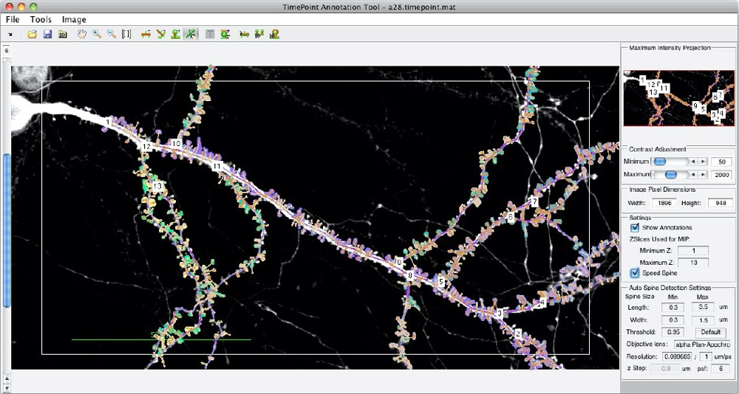
Genentech Evaluates Alzheimer’s Disease Therapeutics with Deep Learning and MATLAB Based Spine Tool
Challenge
Analyze microscopic images to quantify dendritic spine loss, which has been linked to Alzheimer’s disease
Solution
Use MATLAB and Deep Learning Toolbox and work with MathWorks consultants to develop an application that helps automate spine identification and spine density calculations
Results
Labor-intensive image analysis automated
Training time reduced with predefined networks and parallel processing
Classification effort reduced by up to 50%
MATLAB app for automating the detection, annotation, and analysis of dendritic spines.
“We trained a convolutional neural network (CNN) on a data set of more than 9,000 images…. The trained CNN has further automated the process of evaluating therapeutics for minimizing spine loss.” - Justin Elstrott, Department of Biomedical Imaging, Genentech Inc.
Link to article
Notes:
Industries: Biotech and Pharmaceutical, Medical Devices, Neuroscience
Application Areas: Image Processing and Computer Vision, Technical Computing
Capabilities: Algorithm Development, Data Analysis, Machine Learning
Products Used: MATLAB, Computer Vision Toolbox, Deep Learning Toolbox, Image Processing Toolbox, Parallel Computing Toolbox
Country: United States
Published in 2021
Figures/images available in online version
Product names are current at time of technical article publication.
Evaluating Alzheimer’s Disease Therapeutic Targets with Deep Learning and the MATLAB Based Spine Tool
By Justin Elstrott, PhD, Department of Biomedical Imaging, Genentech Inc.
Alzheimer's disease (AD), the most common cause of dementia, is characterized by changes in the brain resulting from the buildup of amyloid plaques. Studies have shown that these hard, insoluble accumulations of beta amyloid proteins are closely linked with the loss of dendritic spines, micron-sized protrusions from a neuron’s dendrite that receive input from other neurons. These studies have led my Genentech colleagues and other AD researchers to preclinically evaluate compounds that reduce spine loss in the presences of amyloid plaques.
To quantify spine loss, we examine microscopic images of mouse brain tissue, counting individual spines along the dendrite and calculating spine density (for example, the number of spines per 100 micrometers of dendrite). When performed manually, this process is extremely labor intensive.
About 10 years ago, our group developed Spine Tool, a MATLAB® image processing application that helps automate spine identification and spine density calculations (Figure 1). While the original version of Spine Tool worked well for in vitro samples, it produced a nontrivial number of false positives and false negatives in ex vivo brain samples, where image quality is lower.
To improve the accuracy of Spine Tool, we worked with MathWorks consultants to incorporate deep learning into the tool. We trained a convolutional neural network (CNN) on a data set of more than 9,000 images that we had annotated with the original Spine Tool. The trained CNN has further automated the process of evaluating therapeutics for minimizing spine loss.
Spine Density Basics
To conduct our studies, we use normal mice (wild-type or WT mice) and mice that express amyloid beta (PS2APP mice), which tend to develop amyloid plaques. Using digital images of microscopic slices of mice brain tissue, we identify and count spines along individual dendrites in both the presence and the absence of visible plaques.
As Figure 2 shows, the presence of the plaque in PS2APP mice corresponds with a visible reduction in the number of nearby spines. That particular study included a third group of mice in which the complement 3 gene (C3KO) was removed; those mice demonstrated significantly less spine loss [1].
We aggregate the spine densities from hundreds of samples to produce a bar chart that compares the densities for different mouse genotypes (Figure 3), revealing that both the reduction in spine density near plaques and the recovery of spine density in C3KO mice are statistically significant. These study results suggest that reducing complement activity could be an effective therapeutic strategy.
Combining Traditional Image Processing with Deep Learning
Earlier versions of Spine Tool identified dendritic spines by applying threshold detection, segmentation, and morphological image processing techniques, as well as custom operations for detecting neuroscience-specific morphologies (Figure 4).
To incorporate deep learning into Spine Tool, we evaluated several predefined network architectures, including Deeplab, SegNet, and U-Net, a network developed for biomedical image segmentation. We chose U-Net for its multiresolution performance.
To reduce training time, we decided to use the 2D version of U-Net rather than the more complex 3D version. Although the data we work with is three-dimensional, it is not isometric: the volumes are only a few slices deep, and a dendritic spine rarely spans more than one or two slices along the Z axis. We created 2D data sets by performing maximum intensity projection of the thin 3D slices. We saved additional time by performing the training on a workstation with NVIDIA® GeForce RTX 2080 Ti GPUs using Parallel Computing Toolbox™.
Initial classification results from the trained network were promising but still included false negatives, identifying fewer spines than we could see ourselves. This was due to a class imbalance problem: the spines are tiny in comparison to the dendrites and the background. We adjusted the class weights across the network and evaluated various loss functions to improve prediction accuracy. We opted to set the weights to maximize sensitivity.
The updated network detected virtually all the spines in an image, but with more false positives. We eliminated these false positive by post-processing the results. For example, we applied length and volume thresholds on the detected spines to weed out any that were too large or too small to be actual spines. To date, our deep learning model shows more promise for time savings than for increased accuracy. The post-processed model predicts ratios of spine density across genotype conditions similar to counts from our ground-truth Spine Tool dataset using traditional image processing (Figure 5), with an up to 50% reduction in manual correction time.
Improving and Validating Spine Tool
Currently we are optimizing the post-processing steps to ensure that neighboring spines detected by the network are properly segmented and counted. Ultimately, we may be able to detect spines more accurately with deep learning than we can via manual inspection, but that capability is not our primary measure of success. Our goal is to verify that, if a treatment effect can be detected by a human, then it can also be detected by the network.
In the coming months, we will use the new deep learning capabilities of Spine Tool to process images for actual studies. In parallel, we will process the images using our existing workflow and compare the results. If, as we expect, the bar charts produced via the two approaches show comparable average spine density, then we will have confirmed that future studies of spine density can be run reliably with the new tool—and with potentially 50% less manual effort.
References
Wu, T. et al. “Complement C3 Is Activated in Human AD Brain and Is Required for Neurodegeneration in Mouse Models of Amyloidosis and Tauopathy.” Cell Reports 28, 2111-2123.e6 (2019).
See more articles and subscribe at mathworks.com/company/newsletters

Slide 13
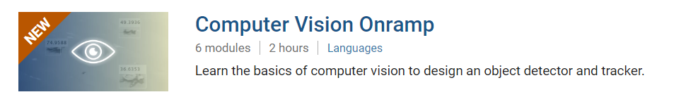
TO DO
Go to https://matlabacademy.mathworks.com/
Log in to your MathWorks account
Launch Computer Vision Onramp

Slide 14
Prizes
Complete at least 50% of Computer Vision Onramp to be eligible for any prize
Bring your laptop when you come to collect the prize
Follow Us on Facebook!
Find us on Facebook at [Insert Facebook Group Name]

